Slide 1
Pianificazione e Gestione Sale Operatorie Modello Multi-Obiettivo e Algoritmi Genetici
LM-41 Medicina TD - PGSS A.A. 23/24
Mimmo Conforti

Slide 2
Outline
Operating room planning and scheduling:
3 main decision levels
Multiobjective model formulation
Solution approach via Genetic Algorithm
Computational experiments
Conclusions

Slide 3
Ingredienti
ATTORI
Specialità Chirurgiche (Team Chirurgici)
Pazienti (Interventi Chirurgici)
RISORSE
Infrastrutture, blocco operatorio, sale operatorie (Operating Room OR)
Tempo utilizzo sala operatoria
Posti letto

Slide 5
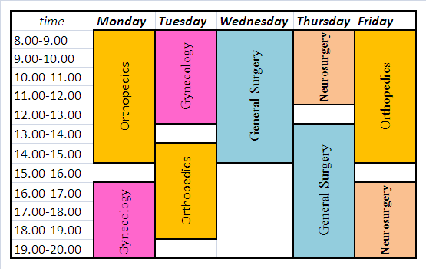
Planning and scheduling problems
Strategic
How much operating room time has to be assigned to several
surgical specialties
Session planning problem:
distribution of OR time
among surgical specialties
Tactical
Construction of
a master surgical schedule
Operational(advanced and operative)
Patients scheduling

Slide 6
Tactical decision level
A set of time blocks is assigned to a surgical specialty for some weeks or months.
Criteria:
Equity assignment
Staff cost minimisation
Bed leveling

Slide 7
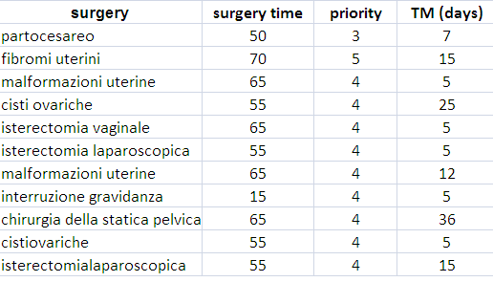
Operational decision level
Scheduling of elective patients
Criteria:
Minimization of waiting time of patients
Resource efficiency maximization
Gynecology
OR

Slide 8


The simplest case: only 1 surgical specialty
OR1
OR2
OR3
OR4
OR5
Open time
Tactical
Operational
Close time
Inconsistent assignment B={OR1,OR2, OR3, OR4, OR5}
Surgeons
Elective patients
SS1

Slide 9
Multi-specialties
Operating room
blocks at the
tactical
decision level
SS1
SS2
SS3

Slide 10
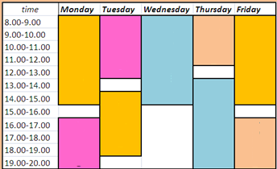
Multi objective model formulation: Main assumptions
the planning horizon is of h days
data are deterministic (emergency and urgent surgeries have dedicated ORs )
each OR has a given number of OR blocks (which should have a different time duration and cannot be shared among surgical specialties)
each surgical specialty has a set of surgical teams (or surgeons);
resources for anesthetic procedures are available in each operating room
SS1
SS2
SS3
SSn
?
?
?
?
?
?
?
?
?
Patient waiting lists

Slide 11
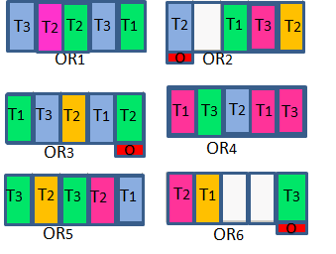
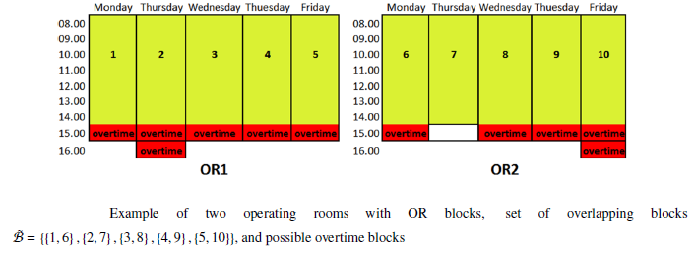
Aim of the multiobjective model
Surgical specialties
Surgical groups
OR time
SG₁
SG₂
SG_{k}
SG₁
SG₂
SG₁
SG₂
SG_{h}
SG₁
SG₂
SG_{k}
OR1
OR2
OR3
OR4
Priority
Max. waiting time
Surgery duration
Waiting patients
OR5
OR6

Slide 12
Notation
SS1
Waiting lists of patients
SS2
SS3
Set of teams
Surgical specialties
SS1
SS2
SS3

Slide 13

Operating room blocks
8 hours
$$d_{b}$$
= time of OR block b
overtime
Surgical specialties
SS1
SS2
SSn

Slide 14
Patients
Note :
expected surgery duration =
setup time (for preparing OR and assembling instruments, supplies and equipment)
+
time from when patient enters the OR until he/she leaves it
+
cleanup time (time needed for disposing of supplies used in a procedure and cleaning room for next patient)

Slide 15

Priority scheduling rules
h
Arrival Date
(waiting list)
Date of
planning
lateness (in days)
mt-et
et
mt-et<=h
L’
set of patients that have to be operated during the planning horizon
mt
et= elapsed time
mt= maximum waiting time
1
2
3
n
L=

Slide 16
Priority scheduling rules
Date of
Planning
H=15
Arrival Date
13
25
3
10
et=10-3=7
Patient 1
mt=10
Earlinss
Tardiness
mt-et<=h
L’

Slide 17
Priority scheduling rules
Date of
Planning
H=15
Arrival Date
10
3
25
et=10-3=7
Patient 2
mt=7
Tardiness
mt-et=7-7=
= 0 < h=15
L’

Slide 18




Priority scheduling rules
L’
$l_{p}^{}$= tardiness
$l_{p}^{}$= earliness
$$w_{p}^{}={pr}_{p}^{}l_{p}^{}$$
$$w_{p}^{}={pr}_{p}^{}$$

Slide 19
inconsistent
assignment
allotted OR time
Scheduling of patients
(capacity of OR blocks)

Slide 20
Five objective functions
Minimization of waiting time of patients
Maximization throughput of scheduled patients
Resource efficiency maximization
Minimization of overtime cost

Slide 21
Multiobjective model formulation
Cov=1

